Slide 1

EXCEL ENGINEERING COLLEGE
(Autonomous)
NH-544 , Komarapalayam, Namakkal
DEPARTMENT OF COMPUTER SCIENCE &
BUSINESS SYSTEMS
“Voice Controlled AI Assistant for Desktop”
MINI PROJECT

Slide 2
TEAM MEMBERS
V. Gokul ( 22CB015)
K. Kavin Kumar (22CB019)
N. Dhinesh Kumar (22CB012)
G. Dhanush (22CB010)

Slide 3



INTRODUCTION
Our custom-built Voice Assistant AI is designed to revolutionize the way you navigate and control your computer.
seamless integration, this assistant empowers you to perform tasks such as searching Wikipedia, browsing Google, managing applications, and engaging in meaningful conversations—all through intuitive voice commands.

Slide 4
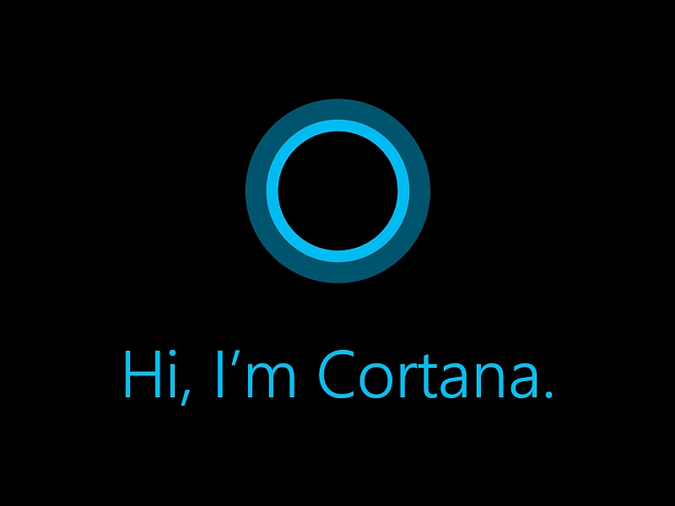
LITERATURE REVIEW
Launch and Development :
Introduced in 2014, Cortana was Microsoft's answer to Siri and Google Assistant. Built on Microsoft’s Bing search engine and integrated with the Windows ecosystem, Cortana aimed to provide a personalized user experience.
Shift in Focusa :
In recent years, Microsoft shifted Cortana’s focus towards productivity enhancements within Microsoft 365, moving away from its original consumer-focused model.
While not open-source, it is a built-in option for those using Windows.

Slide 5
EXISTING SYSTEM
Voice control for Windows settings and applications .
Integration with Microsoft services (Bing Engine).
Reminders, calendar management, and more
Not open-source, it is a built-in option for those using Windows.
Only available in Windows pro version and it is an one of the option.

Slide 6
OBJECTIVIES
Enhanced User Experience (Simplify the interaction with the computer by allowing users to control it using voice commands, making tasks faster and more intuitive)
Productivity Boost (Automate repetitive tasks, such as opening applications, setting reminders, or conducting web searches, to save time and increase efficiency.)
Quick Access to Information (Provide instant access to information from the web, local files, or applications through voice queries).
and more …

Slide 7
OBJECTIVES & FEATURES
VOICE & INTRACTON CONTROL :
It is a Two-way chatting computer's Artificial intelligence helper. You may use voice commands to do any action , such as opening or closing software, websites, and much more.
FILE SYSTEM CONTROLLING :
You can open, close, cut & copy to another path, remove, rename, and access files and folders etc… .

Slide 8
CHAT BOT :
This tool makes work more convenient for the employees because it uses automated programmes to communicate with clients in a human-like manner. It read out loud and print out your responses.
INTEGRATED GOOGLE SEARCH:
It has the ability to perform a Google search without launching a browser or alternatively. you can just ask it to "make a Google search for..." or an opening any websites.

Slide 9
INTEGRATED WIKIPEDIA :
You can also access the Wikipedia search. Employees are simple to note down from Wikipedia. simply say, "Search in wikipedia”.
SIMPLE CONVERSATIONS :
This AI – based NLP ( natural language processing) will be created. You can communicate with this AI like a human because it can understand your languages, and it will also respond to you.

Slide 10
Examples for Simple Conversations :-
You : what are you doing?
AI : I am listening to your voice!
You : what is the time now?
AI : The time is 10:40 AM
You : Hello?
AI : hi!
You : How are you?
AI : I am good. You?
You : I am also fine!
AI : ☺ Glad
You : I love you!
AI : I love u too, but as a friend!
You : Who are you?
AI : I am voice assistant!
You : you are amazing!
AI : ☺ Thanks for you complement!

Slide 11
THE PROCESS UNDERTAKEN TO DEVELOP THIS AI
Define the Purpose and Scope.
Chosen python program language , Framework and Modules.
Dialog Management.
Integration with External Services.
User Experience Design.
Testing Privacy , Security and Evaluation.

Slide 12
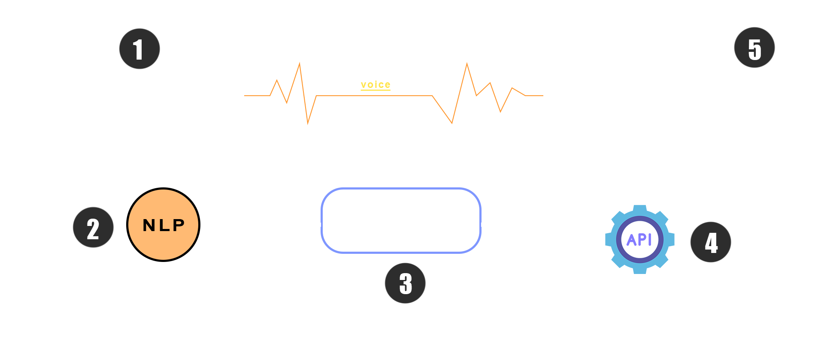
How voice assistant works

Slide 13
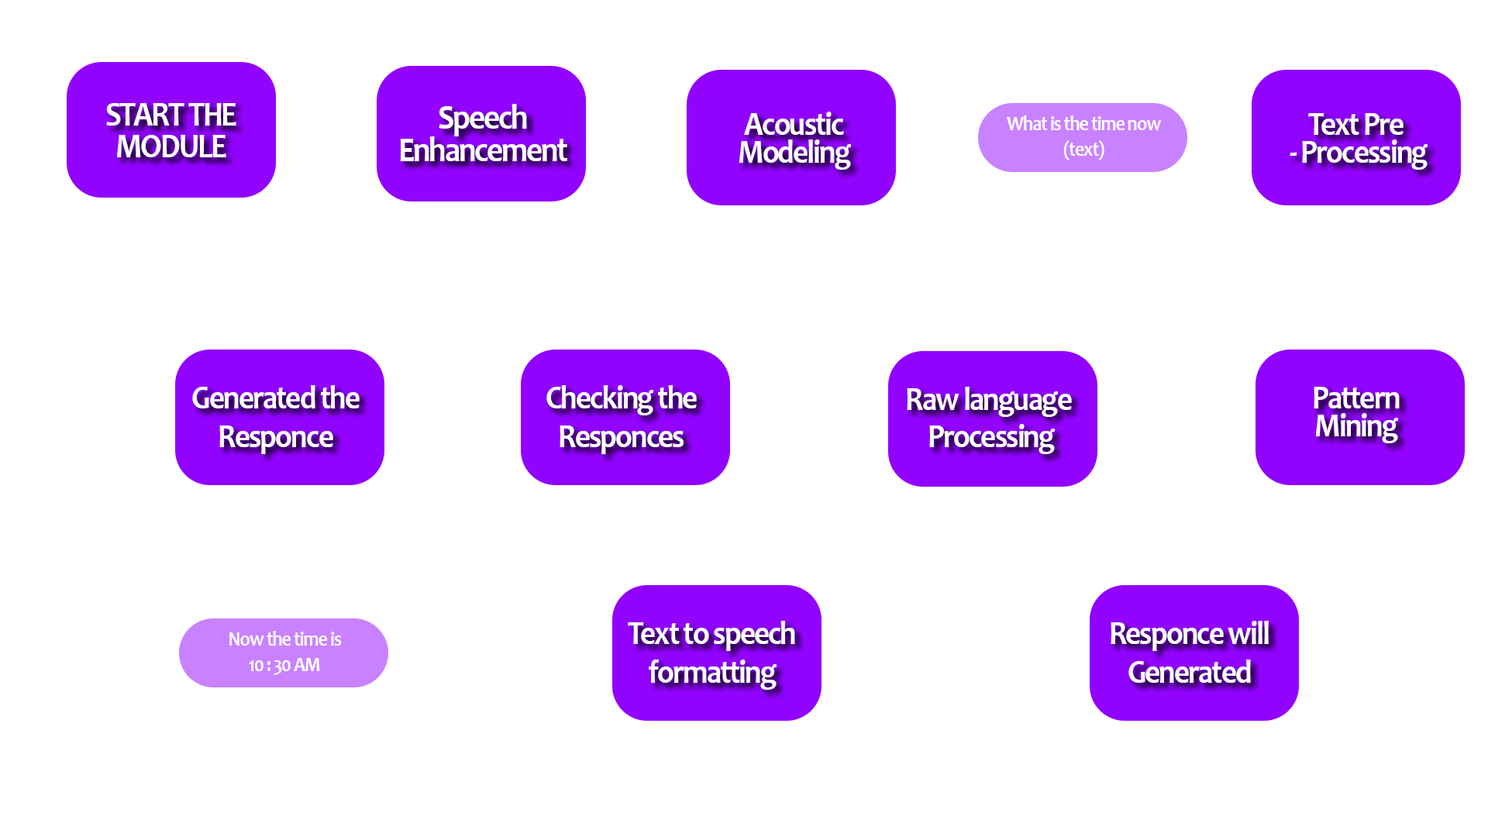
MODULING PROCESSES

Slide 14
WORK DONE
Created a base code as a first step.
Installed basic modules (speech RG , pytrxx3 , nltk )
Yet to be added new other modules ( Wikipedia , google , os , others)
Yet to be feed the Natural Language Process Data sets.

Slide 15




